Slide 1
ELECTRONIC VOTING MACHINE (work progress – v)
Course: CSE299(Junior Design), Section: 11, Faculty: ITN
Team Name: Team Venom
Name of the Members:
1.Tazbin Hossain Zadid – 1520683042
(tazbin.zadid@northsouth.edu)
2. Sadman Alam - 1610544042 (sadman.alam@northsouth.edu)

Slide 2
Introduction
We are making an Electronic Voting Machine as our junior design project. It is not a very small project and we’ll have to complete it before the end of the semester.
That’s why we have divided our work in some steps. This week, we will talk about what are the things we have done in our fifth step.

Slide 3
The Fifth step
Last time, we checked the Arduino Uno and set it up.
This time, we’ve added some wires in their corresponding places and connected the Arduino Uno with the breadboard set up.

Slide 4
Description of work
First, we have checked and set up the Arduino Uno.
Then, we have place some wires in the corresponding places.
By placing those wires we have connected the Arduino Uno and breadboard together.
The ground, 5V, A0, A1, A2, A3, A4 pins of Arduino Uno are connected respectively with the breadboard.
So, for now we have kept our work limited up to this point.

Slide 5
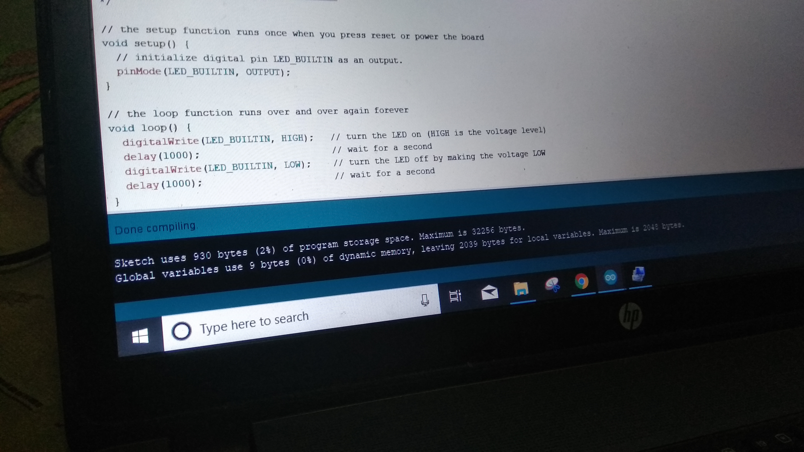
Description of work (continued)
We have attached some screenshots of the installation as a proof of our work.

Slide 6
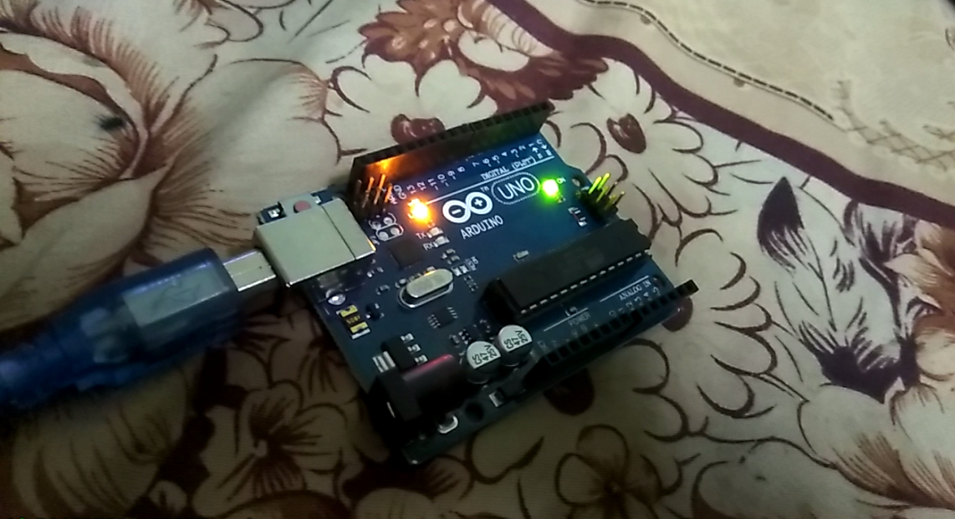
Description of work (continued)

Slide 7
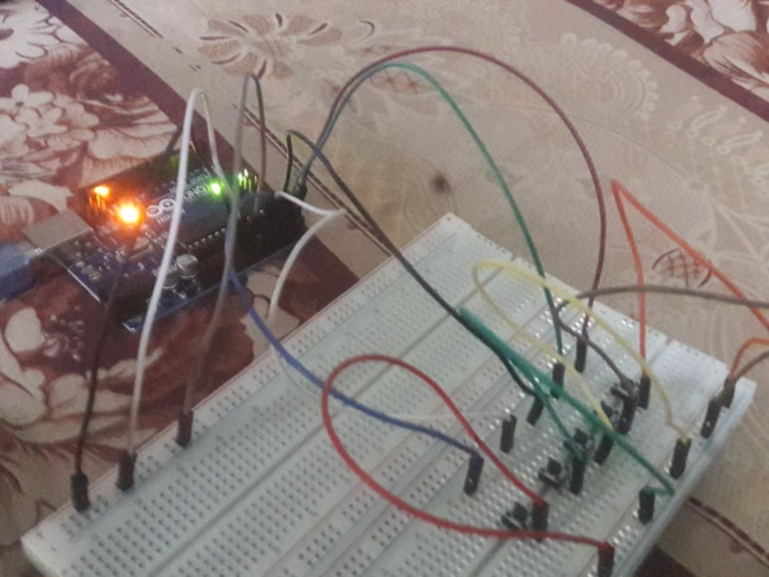
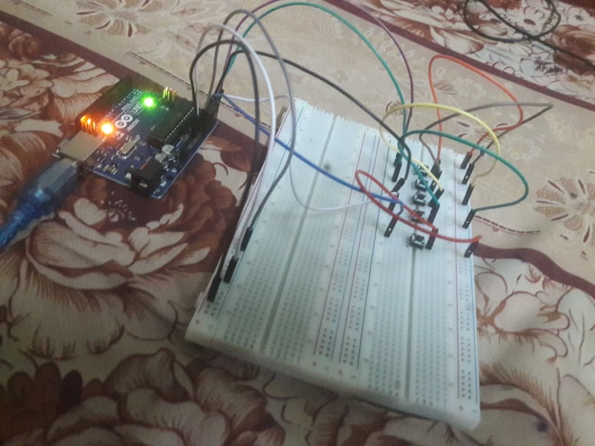
Description of work (continued)

Slide 8
Conclusion
For this week, our motive was to set up the Arduino Uno and connect it together with the breadboard. So, we are satisfied as we have completed our work.
Hopefully, step by step we will be able to complete our project.

Slide 9
THANK YOU VERY MUCH !!!!!!

